Slide 1
Lecture 26: CFG to PDA (Empty Stack)
Agenda:
CFG to PDA Conversion with empty Stack
Steps to convert CFG to PDA
Example
Presented by
Prof. Vaibhav Narayan Chunekar
K. J. Somaiya College of Engineering, Vidyavihar, Mumbai
KJSCE

Slide 2
Convert
Context-Free Grammars to
PDAs by Empty Stack
KJSCE

Slide 3
General Method for Construction of CFG to PDA by empty Stack
1. Convert the given CFG to Greibach Normal Form(GNF)
2.From the start state q0 of the PDA
a)Add a transition to a new state q1 with the label
( λ, $;S$)
3. For each production rule of the form T→ aUXY$.....
a) Add a transition from q1 to q1 with the label
( a,T;UXY$.......)
4. From state q1, add a transition to a new final state q2 with the label ( λ, $;$)
KJSCE

Slide 4
Formal Definition of a PDA
A pushdown automaton (PDA) is a seven-tuple:
M = (Q, Σ, Г, δ, q₀, z₀, F/Φ)
Q A finite set of states
Σ A finite input alphabet
Г A finite stack alphabet
q₀ The initial/starting state, q₀ is in Q
z₀ A starting stack symbol, is in Г // need not always remain at the bottom of stack
F A set of final/accepting states, which is a subset of Q
δ A transition function, where
δ: Q x (Σ U {ε}) x Г –> finite subsets of Q x Г*

Slide 5
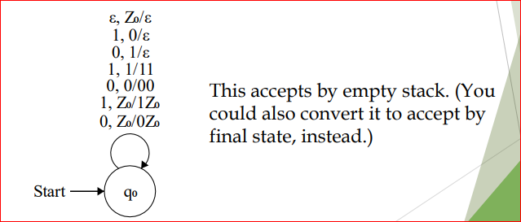
Example: Language Consist of Strings with equal numbers of 0’s and 1’s.
KJSCE

Slide 6
Conversion of Context free Grammar to PDA: Palindrome of String
Convert the Grammar :
S→aSb
S→bSb
S→c
KJSCE

Slide 7
Rules
(qo,λ,$)= (q0, S)----------------1
(qo,λ,S)= (q0, aSa)-------------2
(qo,λ,S)= (q0, bSb)-------------3
(qo,λ,S)= (q0, c)----------------4
(qo,a,a)= (q1, λ )----------------5
(qo,b,b)= (q1, λ )---------------6
(q1,b,b)= (q2, λ )---------------7
(q2,c,c)= (q3, λ )---------------8
KJSCE

Slide 8
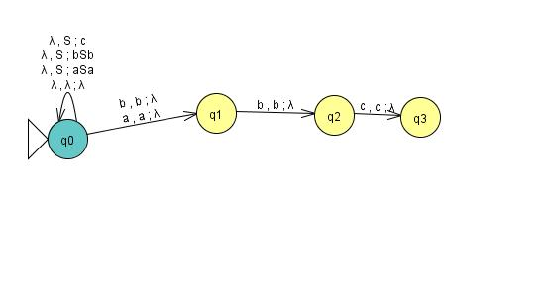
Transition Graph
KJSCE

Slide 9
Test with String
State Unread Stack Transition Rule
q0 abbcbba λ ……….1
q0 abbcbba S ……….1
q0 abbcbba aSa ……….2
q0 bbcbba Sa ……….5
q1 bbcbba bSba ……….3
q1 bcbba bSbba ………3
q1 cbba cbba ……….8
q1 bba bba ……….
KJSCE

Slide 10
State Unread Stack Transition Rule
q2 ba ba
q2 a a
q2 λ $
KJSCE

